Slide 1
Fundamentals of quantum information project
Aritra Sarkar ()
Naveen Kumar ()

Slide 2
Presentation overview
Introduction
Algorithm Implementation
Results
Conclusion
Questions

Slide 3
Introduction
Pattern Matching
Pattern matching is the act of checking a given sequence of tokens for the presence of the constituents of some pattern.
Pattern matching is very useful problem in big data analysis and for machine learning algorithm's classification stage.
Grover’s algorithm is most famous quantum search algorithm.
We aim to use a quantum search algorithm which is improvement of the Grover's algorithm for pattern matching.

Slide 4
Introduction
Oracle
In complexity theory and computability theory an oracle machine is an abstract machine used to study decision problems. It can be visualized as a Turing machine with a black box, called an oracle, which is able to solve certain decision problems in a single operation.
Oracle with a yes or no answer only.
Grover algorithm assumes that oracle exists and does not say anything about processing required.
However for every practical algorithm, we need to consider both construction or the oracle, as well processing
Toolset:
OpenQL; QX; QuInE; MATLAB/Octave

Slide 5
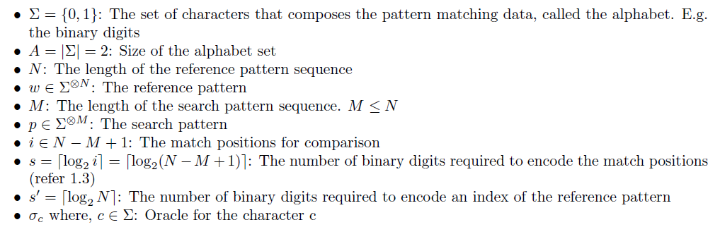
Algorithm Implementation
Notation:

Slide 6
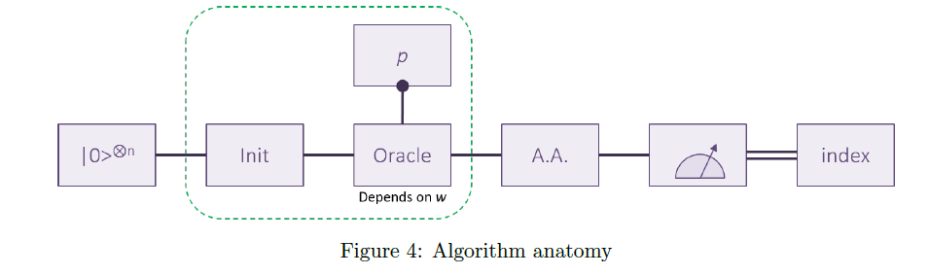
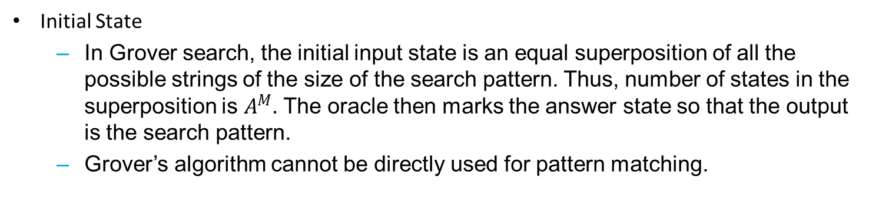
Algorithm Implementation
Initial State
In Grover search, the initial input state is an equal superposition of all the possible strings of the size of the search pattern. Thus, number of states in the superposition is $A^{M}.$ The oracle then marks the answer state so that the output is the search pattern.
Grover’s algorithm cannot be directly used for pattern matching.

Slide 7
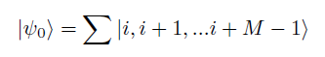
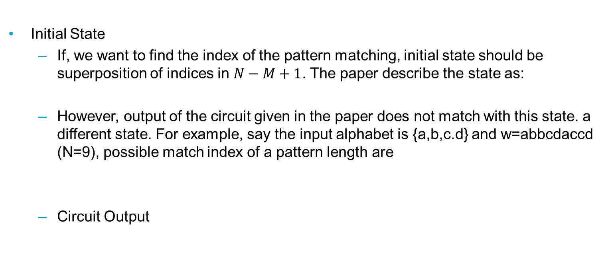
Algorithm Implementation
Initial State
If, we want to find the index of the pattern matching, initial state should be superposition of indices in $N−M+1$. The paper describe the state as:
However, output of the circuit given in the paper does not match with this state. a different state. For example, say the input alphabet is {a,b,c.d} and w=abbcdaccd (N=9), possible match index of a pattern length are
Circuit Output

Slide 8
Algorithm Implementation
Oracles
In Grover search, the oracle function basically stores the relationship between the database and the search. This relationship thus needs to change for each search string, making it impractical for implementation.
The core idea in quantum pattern matching is to define a “compile once, run many” approach,
The Algorithm defines multiple oracles, one for each character of alphabet.
Note that oracle construction is independent of the search string, giving this algorithm its usefulness.
However, oracle circuit assembly depends on the search pattern.
Thus it can be imagined that at every iteration step, all the oracles exist in the circuit but only one of them is control activated by the step’s corresponding digit of the search pattern.

Slide 9
Algorithm Implementation
Oracles
Circuit for constructing an arbitrary Boolean function is not proved in the paper.
We devised our own circuit that can be generated automatically in an OpenQL kernel.
In our implementation, we run sequentially through the Boolean function. If the state of a particular index needs to be marked, the value of the index is taken.
Thus a CPHASE is applied on all the qubit to the oracle, with inverted control on qubit where the Boolean index is 0.

Slide 10
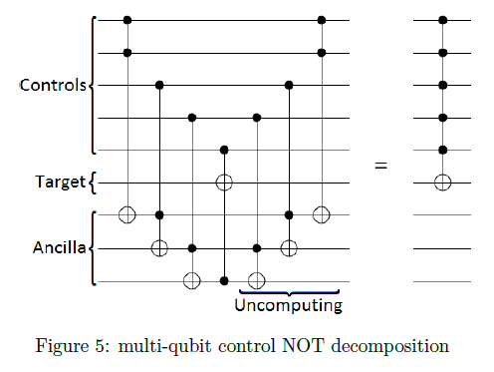
Algorithm Implementation
Amplitude Amplification
The third part of the circuit is the Grover amplification process over the entire non - ancilla qubit set.
Both in the initial and the oracle circuits as well as for the Grover amplification step, the general algorithm of circuit construction is n-qubit control.

Slide 11
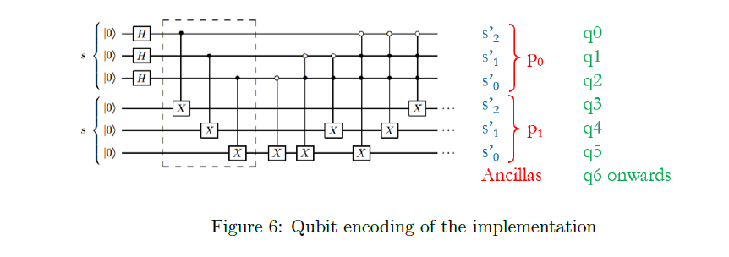
Algorithm Implementation
Qubit Encoding Scheme
The Circuit in the paper does not mark the qubit naming and is thus left to us to interpret the LSQ (least significant qubit) and the MSQ (most significant

Slide 12
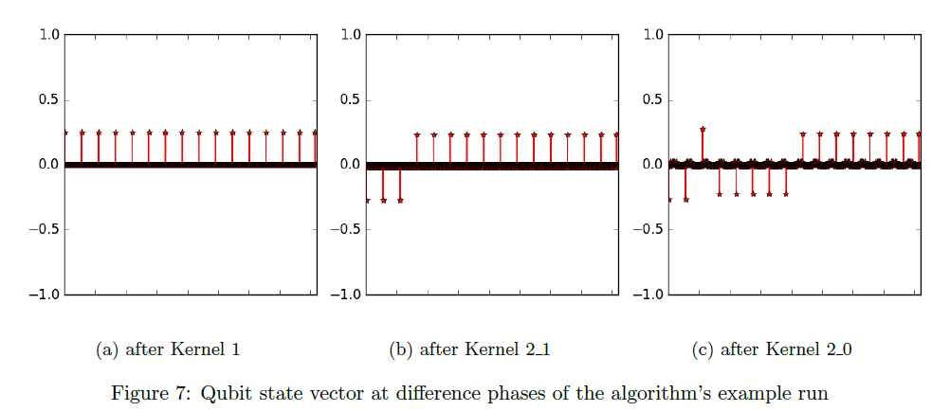
Results
Here the different stages of the run for the search string p = "10" in reference string w = "111000000" is
presented.

Slide 13
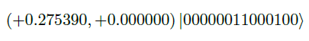
Results
Number of repetition of the experiment depend on the confidence with which we want to distinguish the solution state.
For the given example, the solution state is
while the next two largest amplitude are
Thus, we need to distinguish between the probability amplitudes of 0.0758396521 and 0.069522923584, requiring in the order of 100 tries to obtain the 3rd decimal place confidence.

Slide 14
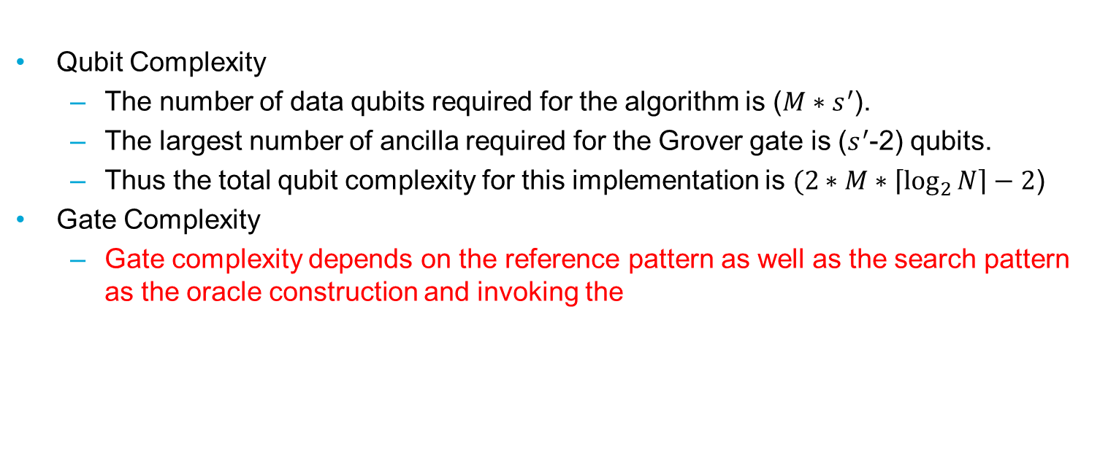
Results
Qubit Complexity
The number of data qubits required for the algorithm is ($M∗s^{′}$).
The largest number of ancilla required for the Grover gate is ($s^{′}$-2) qubits.
Thus the total qubit complexity for this implementation is $(2∗M∗\left\lceil \log_{2}{N}\right\rceil −2$)
Gate Complexity
Gate complexity depends on the reference pattern as well as the search pattern as the oracle construction and invoking the

Slide 15
Algorithm Implementation
Quantum Biology
naturally occurring QM phenomena advantages, not necessarily for Computational purpose
e.g. photosynthesis, navigation in birds, neurons firing, … (sense of smell, emotions, past life, etc.…. keeps getting weirder)
Quantum Genomics
Quantum-accelerated Sequencing
Quantum-accelerated Analysis
nano-pore based long reads,
quantum tunneling..etc.
Genome Assembly Pipelines
Algorithmic Information Theory
Quantum Machine Learning
Pattern Recognition
Evolutionary Algorithms

Slide 16


Related fields

Slide 17
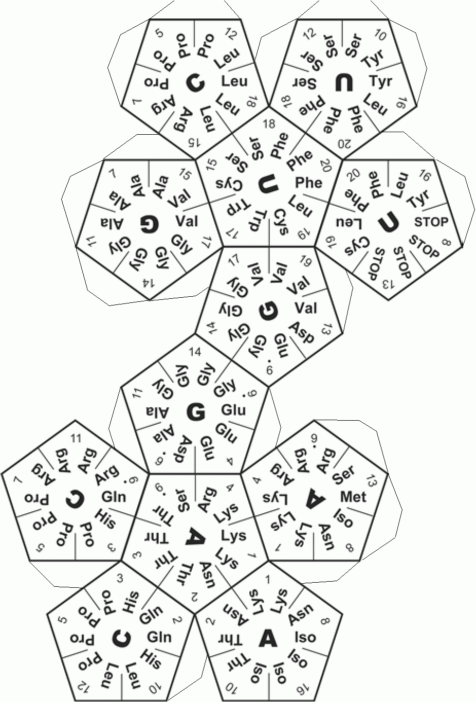

Digress
Linguistics and DNA codes (digram learning), Kolmogorov complexity of genes
Exploit structure in reference genome
Q search on structured data
Dihedral group HSP + Grover search ensemble algorithm
Quantum Quines
Evolving recursive quantum circuit model
Develop short-term use-case of same/similar algorithms (lower qb versions)
Machine learning of ECC patterns (ref. Quantum Software Manifesto 2017)
General pattern recognition in image processing (big data)

Slide 18

Literature review ^{(so far)}
Q-Search in general
QuAM (Dan Ventura et al.)
Q Pattern Matching (Lloyd Hollenberg)
Q Pattern Matching (Yasser Omar et al.)
Q Pattern Search (Ri-Gui Zhou et al.)
QFT based

Slide 19
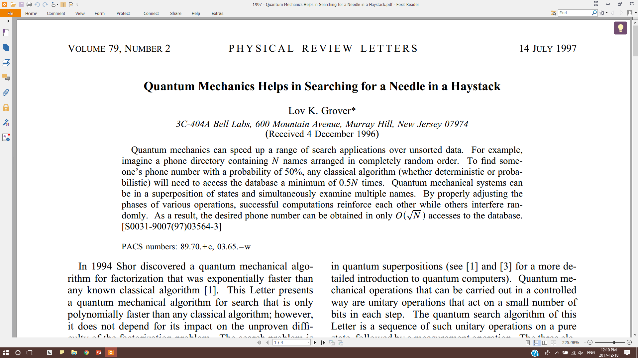
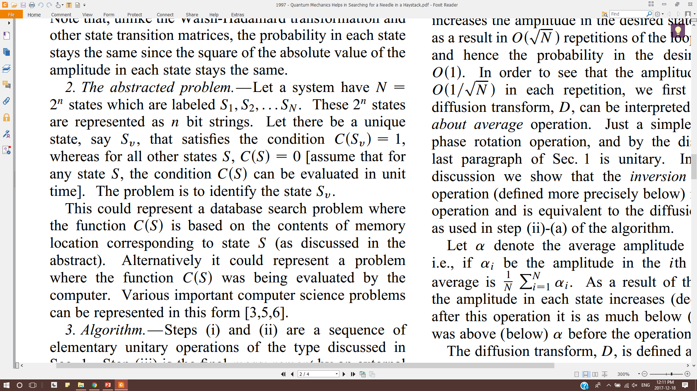
Grover search
Key features
unstructured database
assumes existence of an Oracle
quadratic reduction in query complexity
Anatomy
|0>^{⊗n}
H^{⊗n}
Oracle
A.A.
p
Depends on RG:SR relation
RG: Reference Genome
SR: Short Read
Σ: Alphabet

Slide 20


Grover-like
Why so few Q-Algorithms?
needs to be better than All Classical equivalents
{H,Toffoli} is Universal Gate Set
Fundamentally different from Classical Algo.
What it means for an algorithm to be (Shor/)Grover-like?
Depends on (QFT/)Amplitude Amplification
Promising Candidates
Quantum Associative Memory (D. Ventura et al.)
return the nearest match to the search string
based on Quantum Phone Directory; Quantum Perceptron Model
Quantum Pattern Matching (P. Mateas et al.)
return index of a sub-string
Quantum Kernel
Classical Pre-processing
Encode States in Superposition
Quantum Walk
Physical Simulation
Classical Post-processing Distill the Solution State
Hidden Subgroup Problems
Annealing
Amplitude Amplification

Slide 21
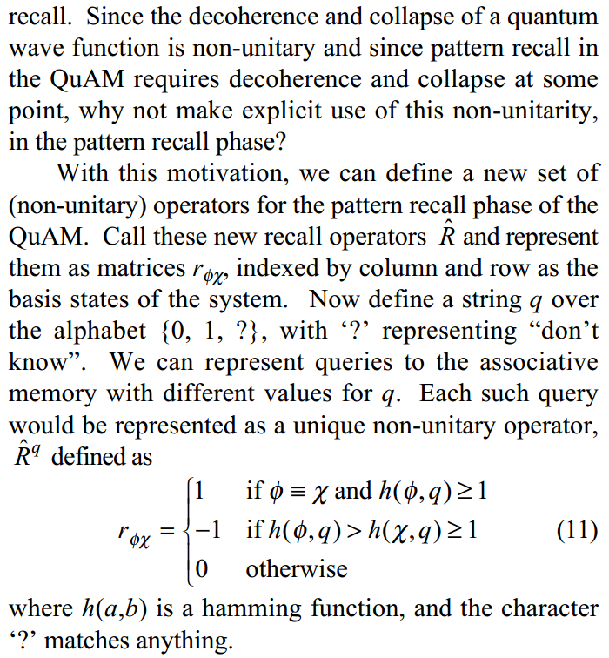
QuAM
Anatomy
Pros
RG and SR dependencies well segregated
Suited for Partially known strings (Ins-Del-Gap)
Good for Seed-&-Extend
Qubit scaling depends on SR and Σ size (not RG size)
Cons
Gives back the SR, not its position in RG
Recall is a Non-Unitary matrix/oracle (tbd: has an Unitary version)
RG needs to be split into SR size blocks for storing
|0>^{⊗n}
Store
Recall
SR
Depends on RG
Depends on partial/approx SR

Slide 22
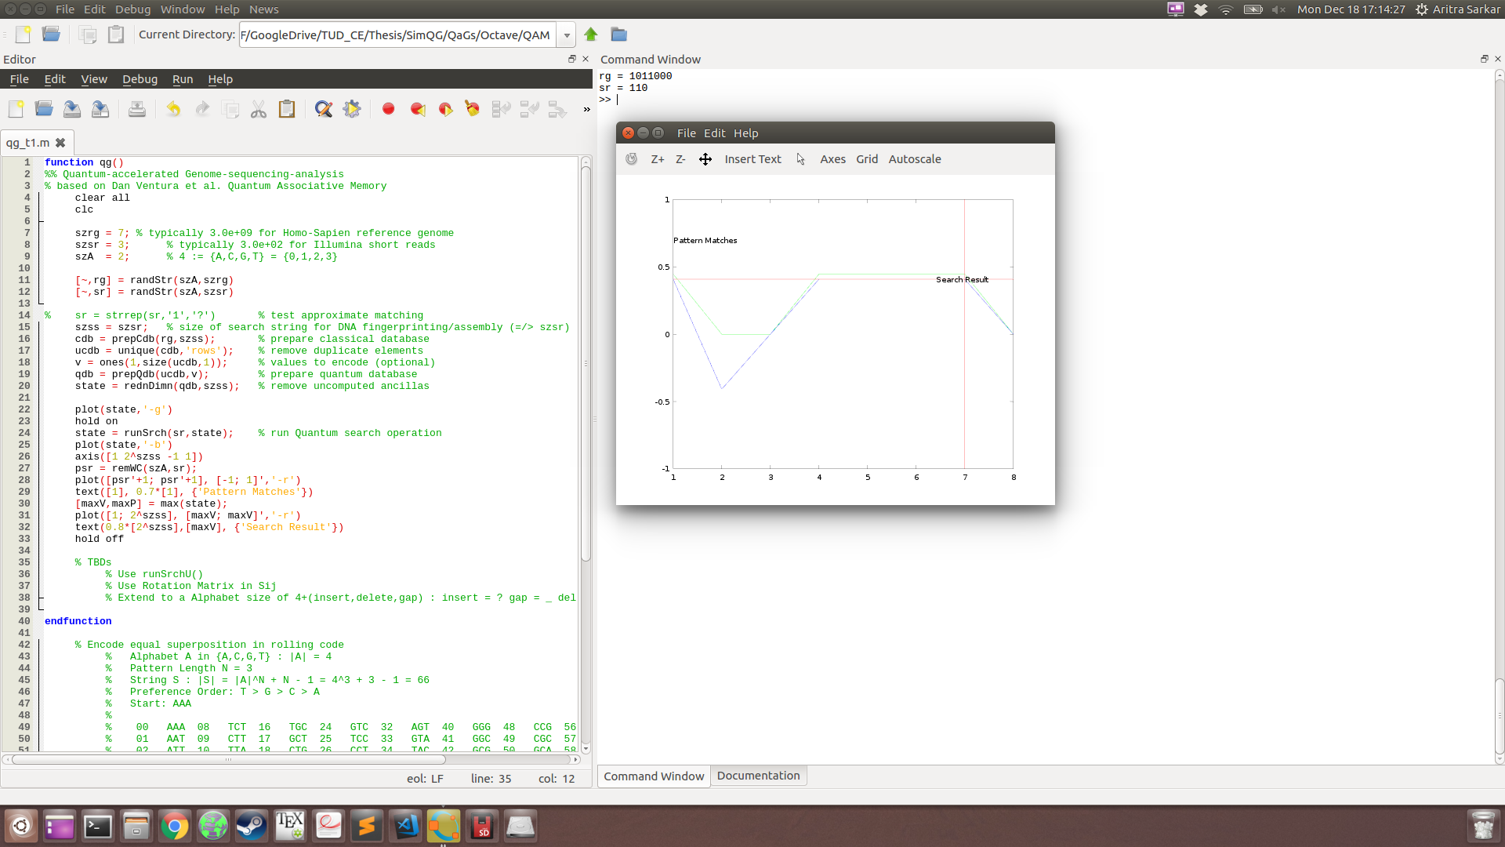

QuAM demo

Slide 23
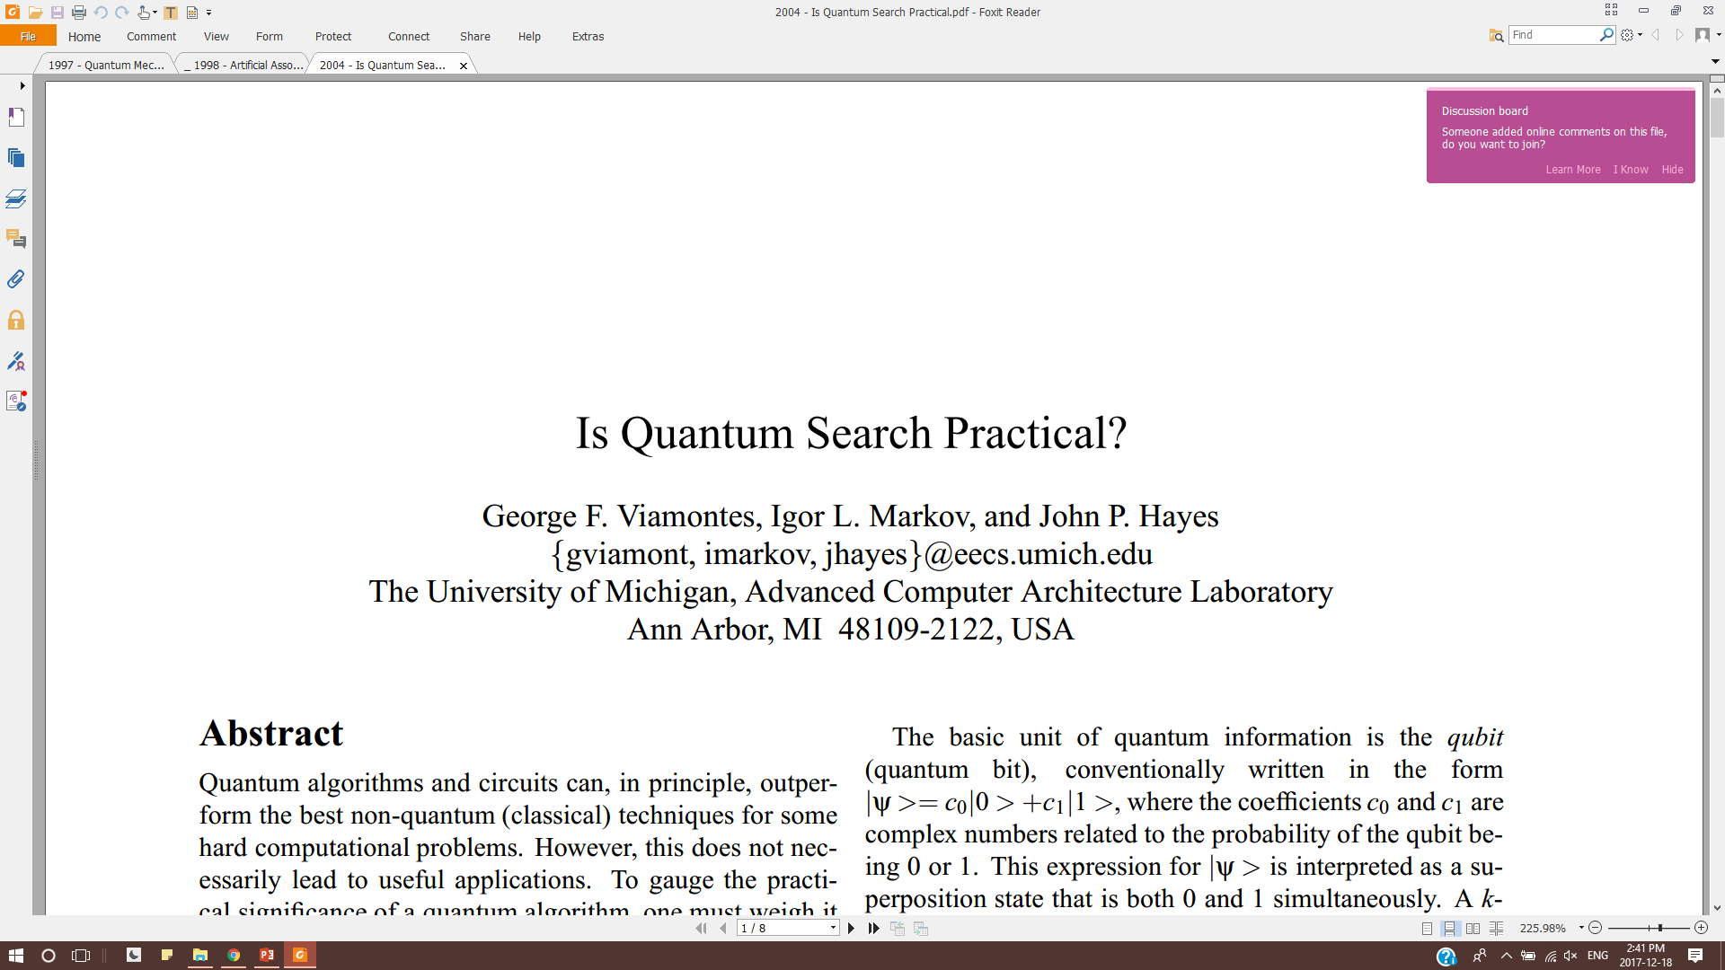
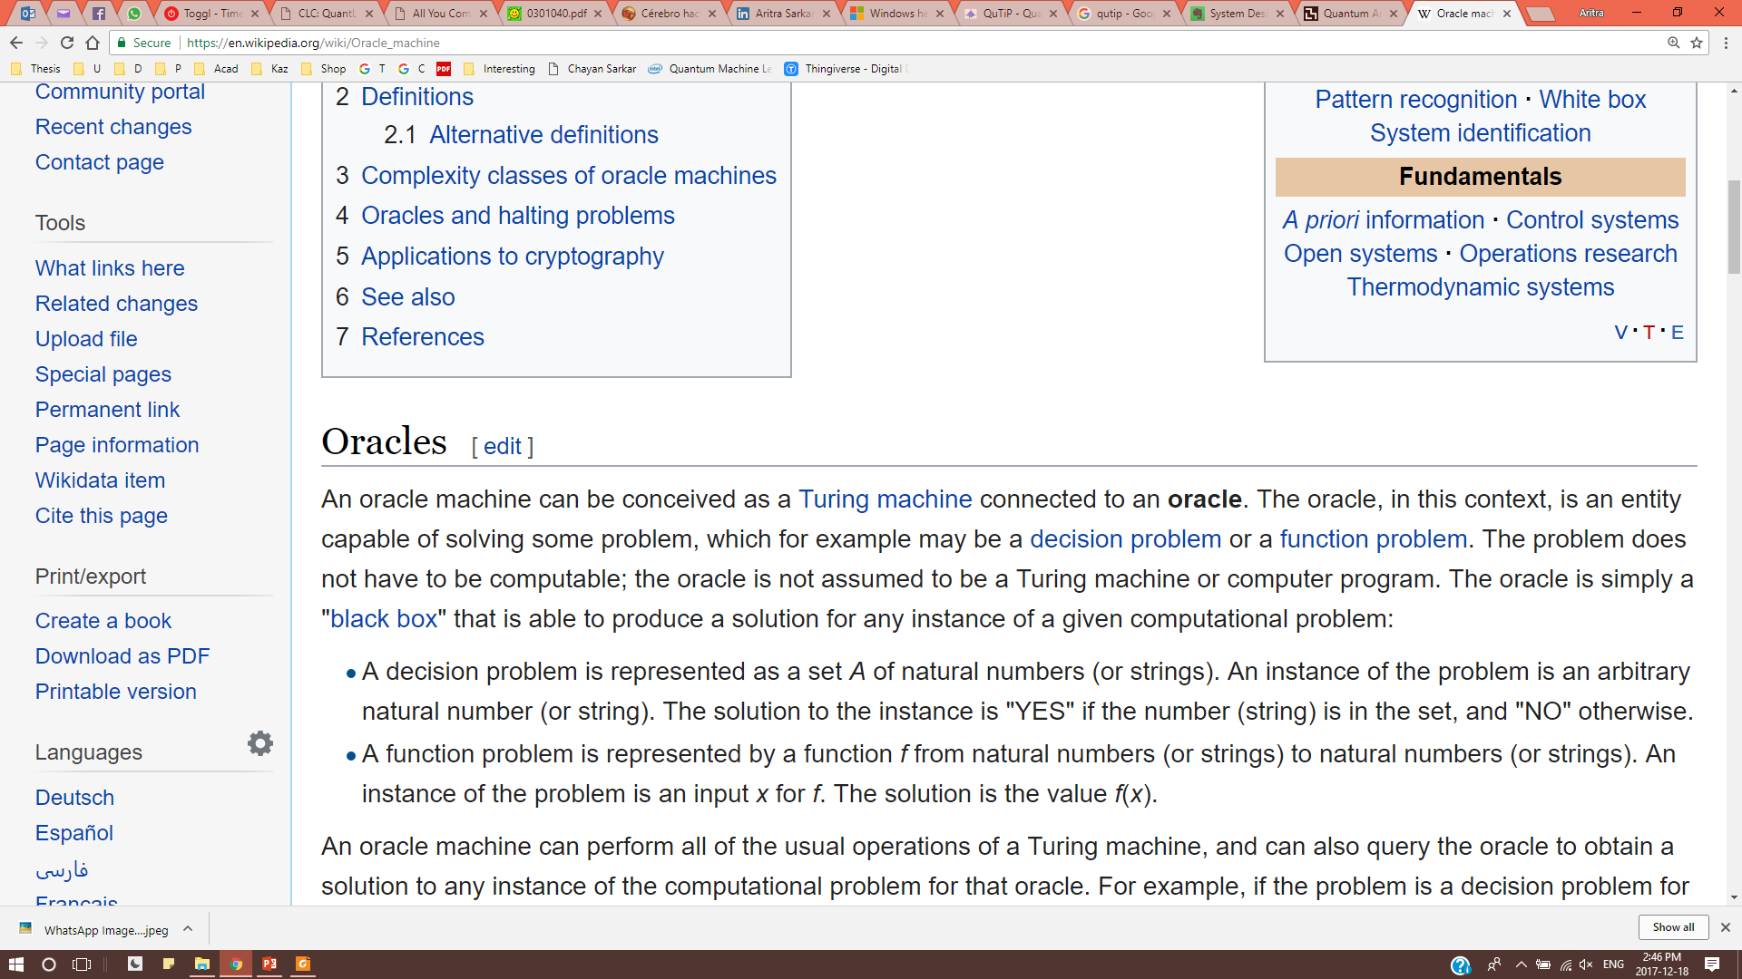
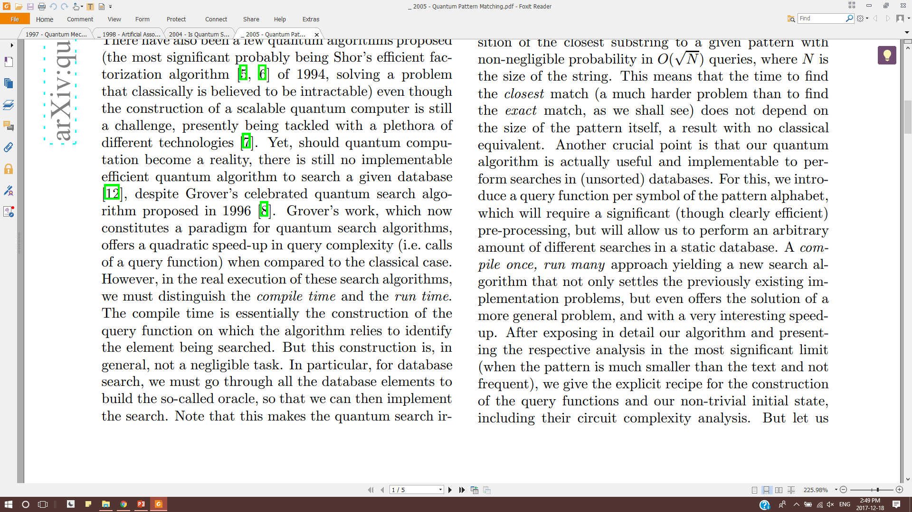
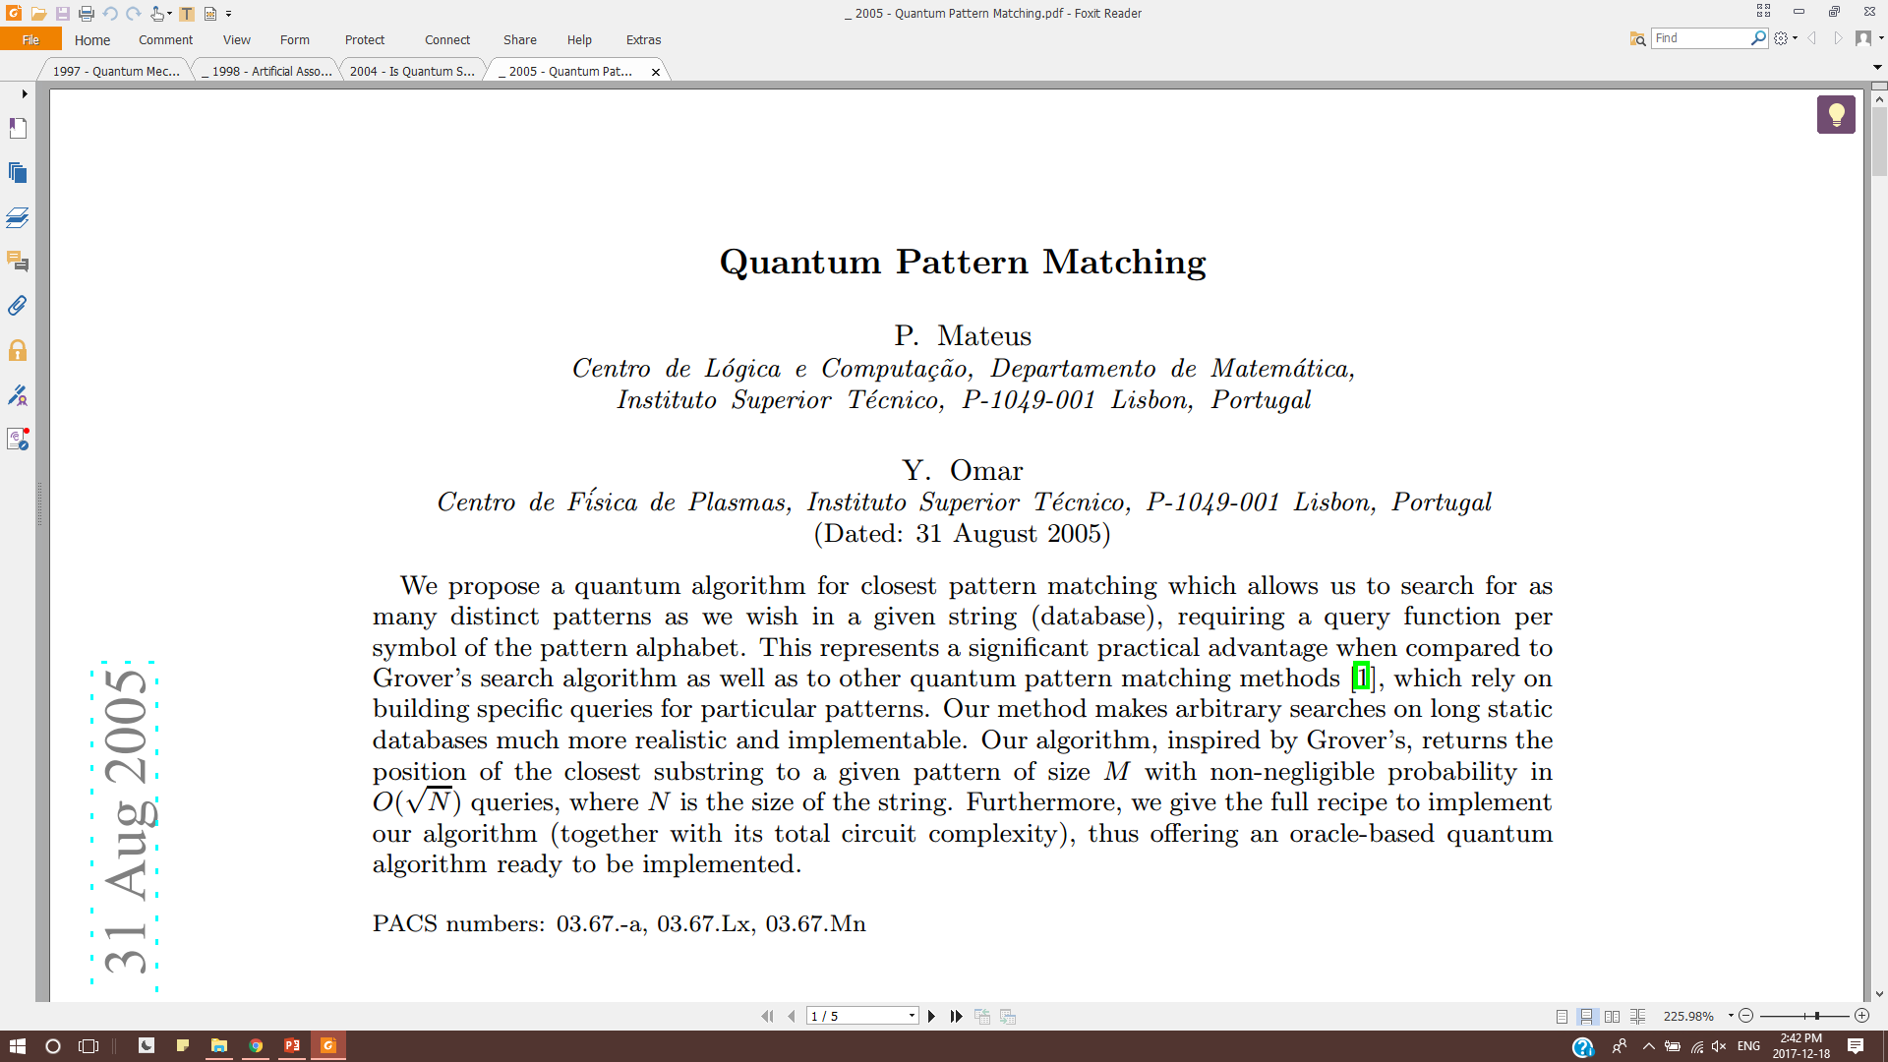
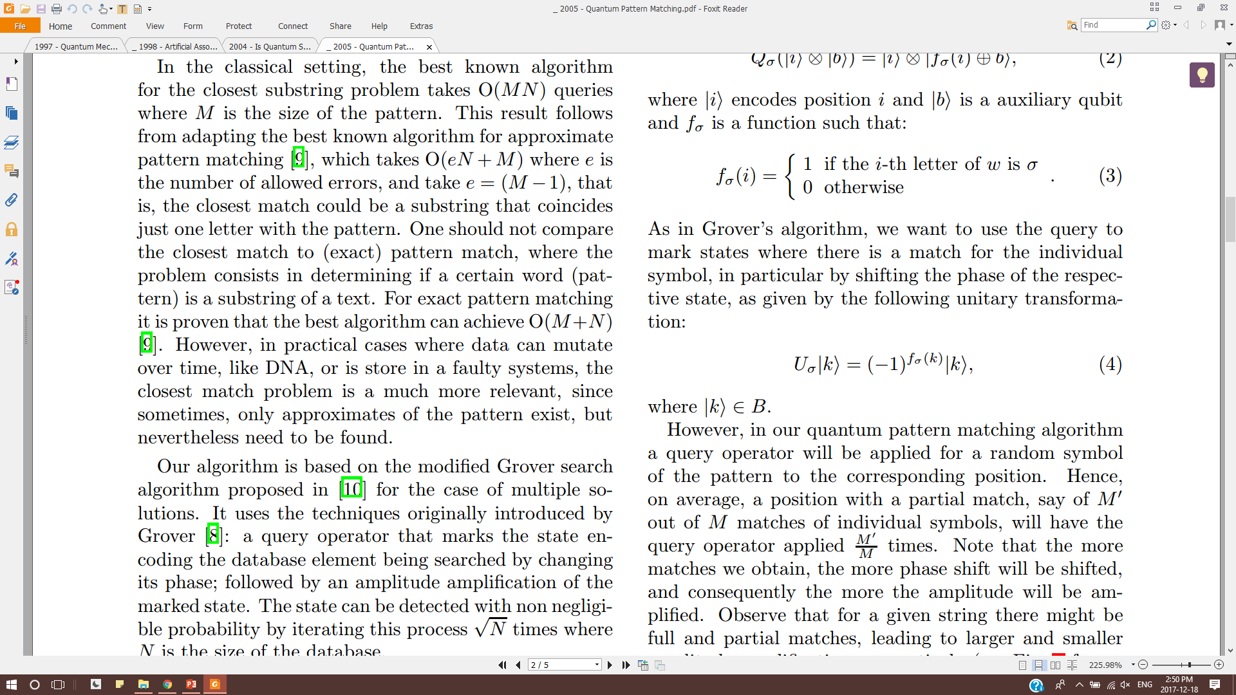
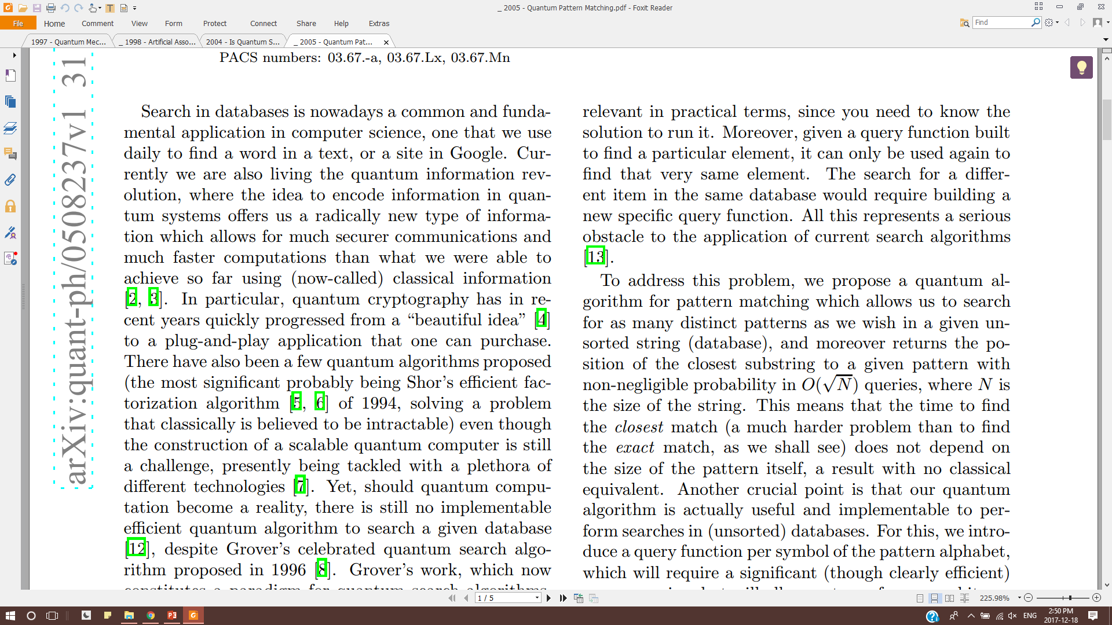
Q-search (de-)motivation
Compile once, run many
Oracle independent of SR

Slide 24
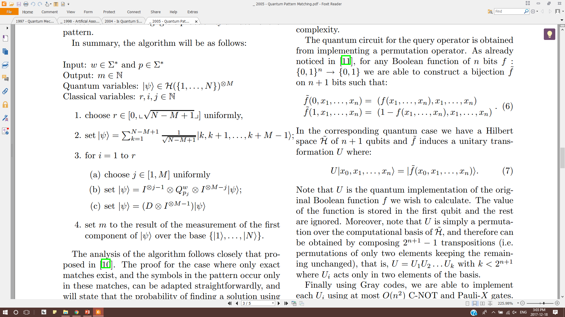
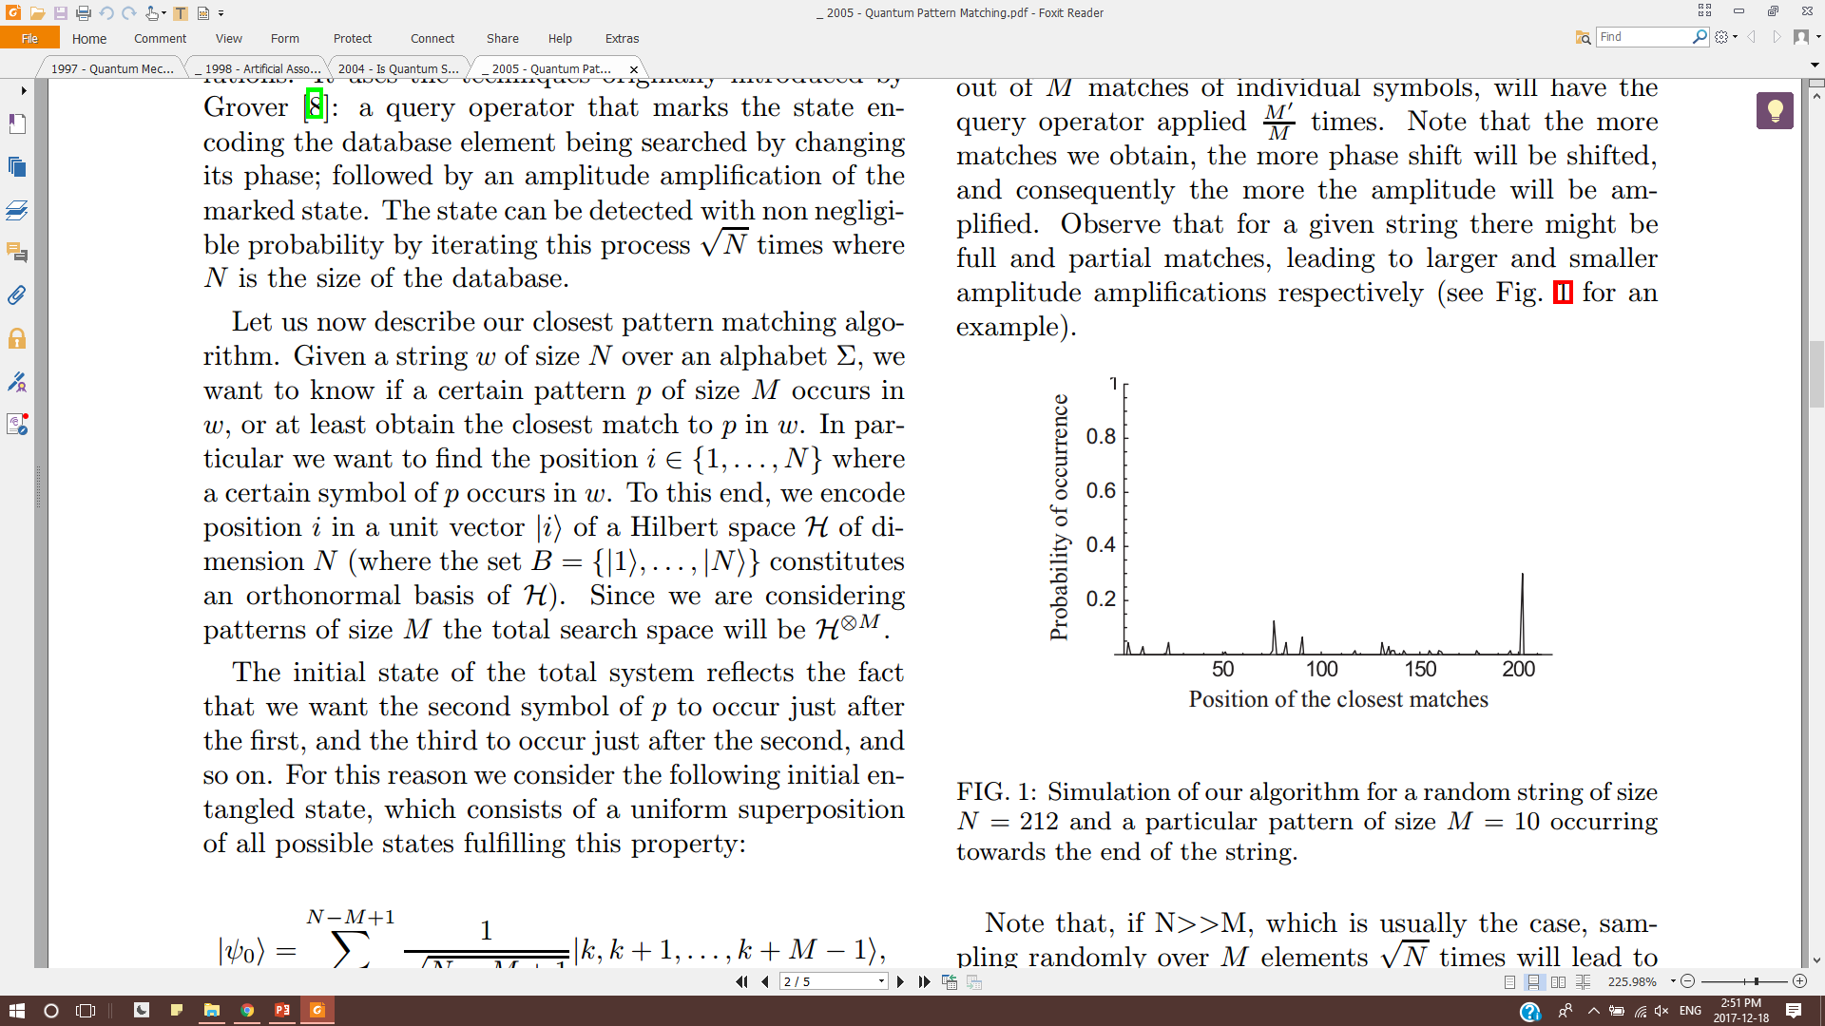
QPM
SR
|0>^{⊗n}
Init
Oracle
A.A.
index
Depends on RG

Slide 25
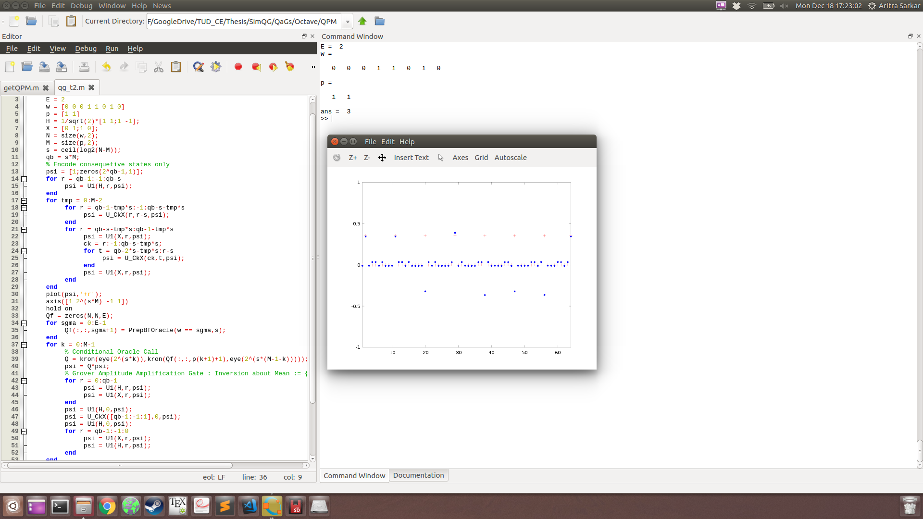
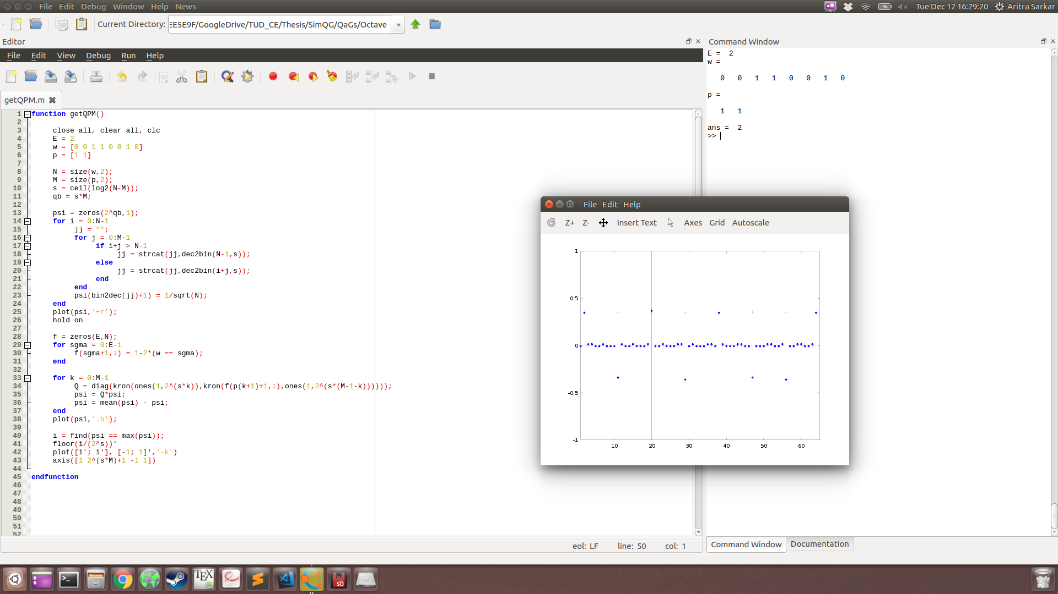
QPM demo

Slide 26

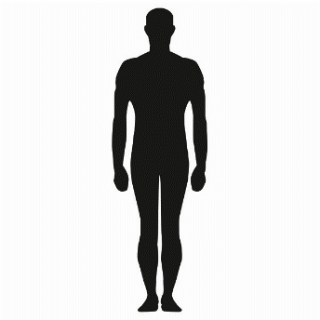
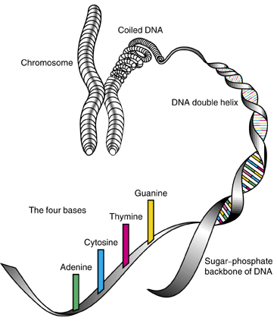
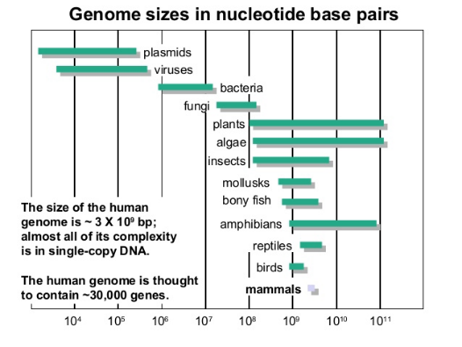



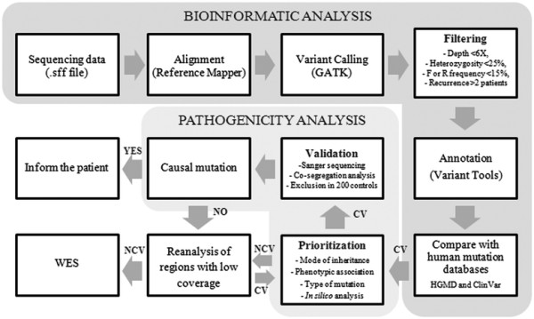
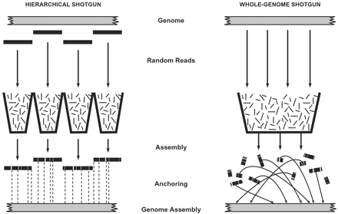
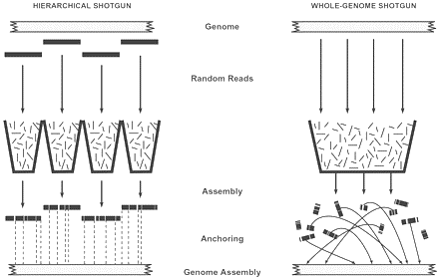
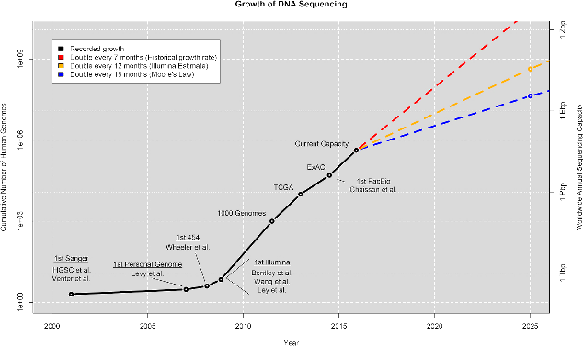
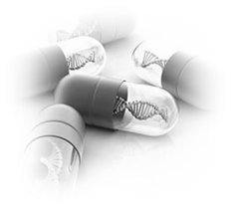
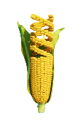

Genome-sequence analysis
Heuristics
Present
Alignment
reduce Approximations
of Smith-Waterman
Exact
Future
De novo
reduce Reference Genome Bias
Alignment
or
De-novo
2-40 EB/year
Genomical Big Data
Notes:
Better understanding and easier access to the genetic structure of humans, microbial organisms or plants will open up new vistas
for example, in personalized medicine, cancer treatments and better crop yields
The genome of an organism is organized into manageable partitions of DNA, called chromosomes
The double-helix DNA structure is made with repeating patterns of phosphates, sugar and 4 nucleotide bases (adenine, guanine, thyamine and cytocine)
Reading out the entire base-pair sequence at one go is not possible and thus broken into smaller chunks
These shorter sequences are then reassembled to construct the organism’s DNA sequence for further analysis
A human genome is approx. 3 billion base pairs long and thus current state of the art sequencing methods involves large parallel systems in GPU clusters
With Genomical big data set to eclipse all other forms of data volume soon, it seems to be the perfect target for utilizing quantum computing’s processing power

Slide 27
Genomic QPM
Alphabet set = Σ = {A,C,G,T} = {0,1,2,3} in Radix-4
Alphabet size = |Σ| ≈ 4
Reference Genome size = N = |ω| ≈ 3x10⁹ ≈ 2³⁰
Short Read size = M = |p| ≈ 100 ≈ 2⁷
Reference Genome = ω ϵ Σ^{⊗N}
Short Read = p ϵ Σ^{⊗M}
Position encoding size = s = ceil(log₂(N-M)) ≈ ceil(log₂N) for N>>M ≈ 30
Initial state = |ψ₀>
Total number of logical qubits required ≈ 3000
+ Ancillas
+ QEC

Slide 28
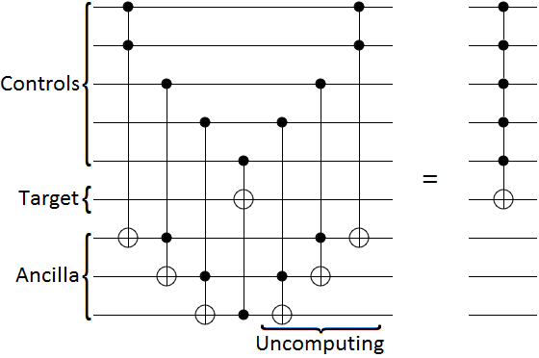
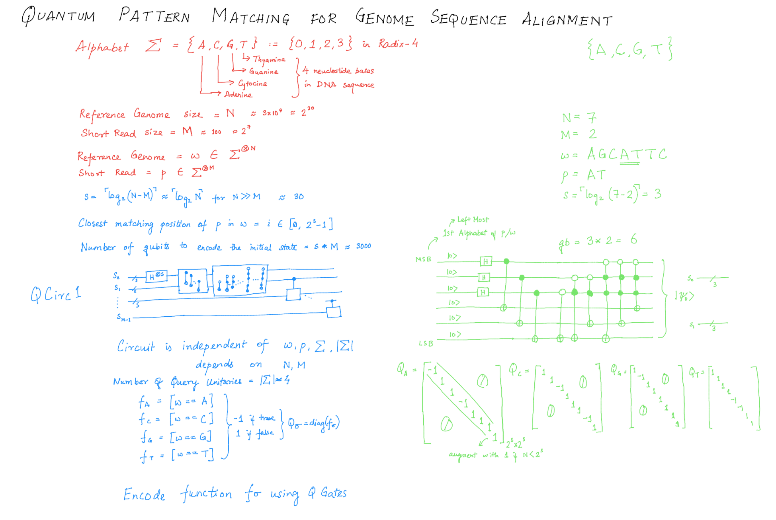
Proof-of-concept
Σ = {A,C,G,T}
|Σ| ≈ 4
ω = AGCATTC
p = AT
N = 7
M = 2
s = 3
Initial state = |ψ₀>

Slide 29
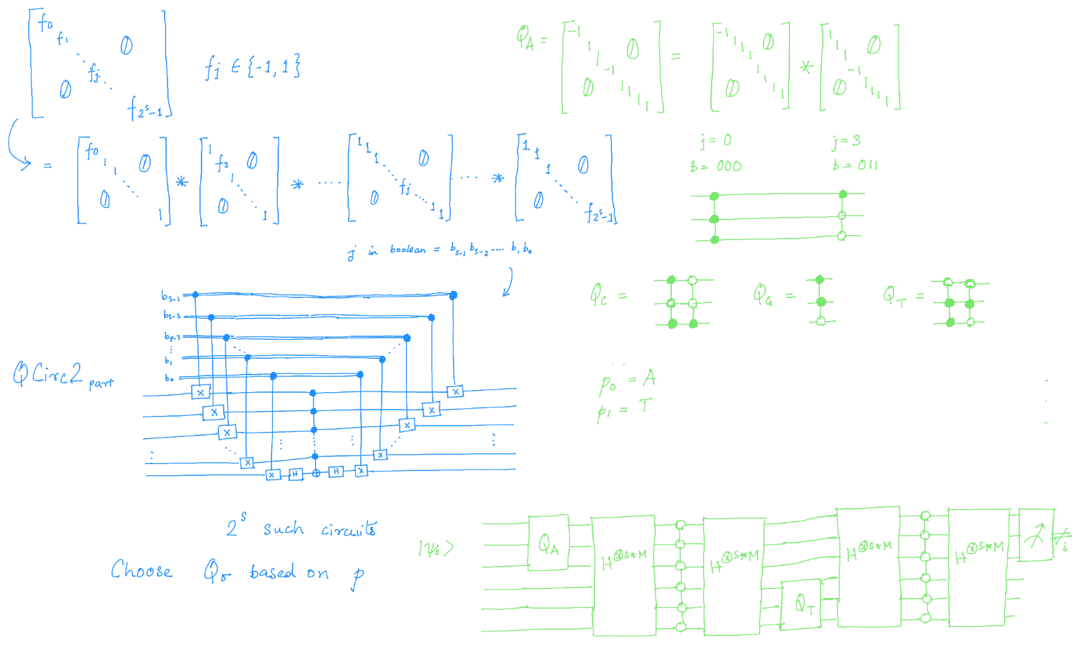
Proof-of-concept
Σ = {A,C,G,T}
|Σ| ≈ 4
ω = AGCATTC
p = AT
N = 7
M = 2
s = 3
Oracle construction

Slide 30
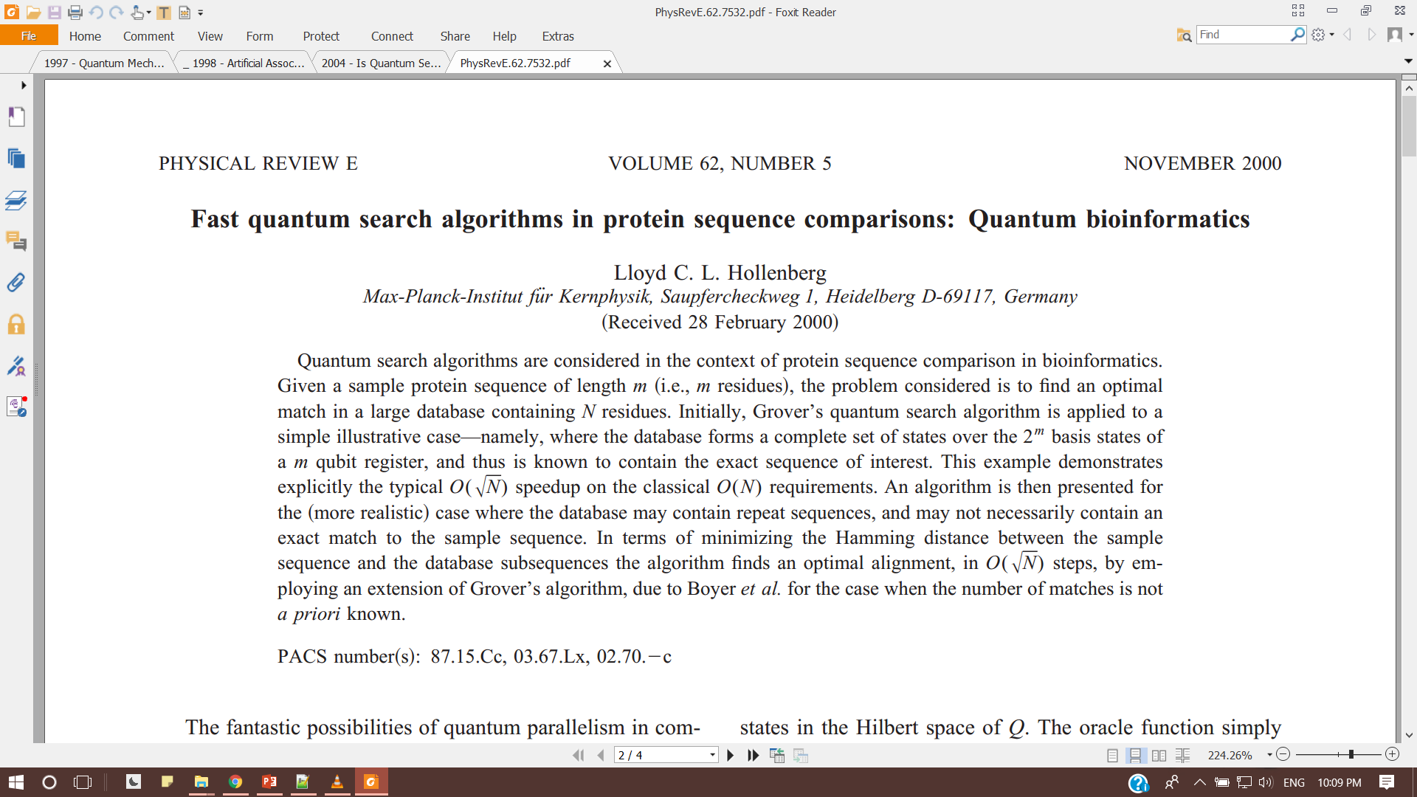
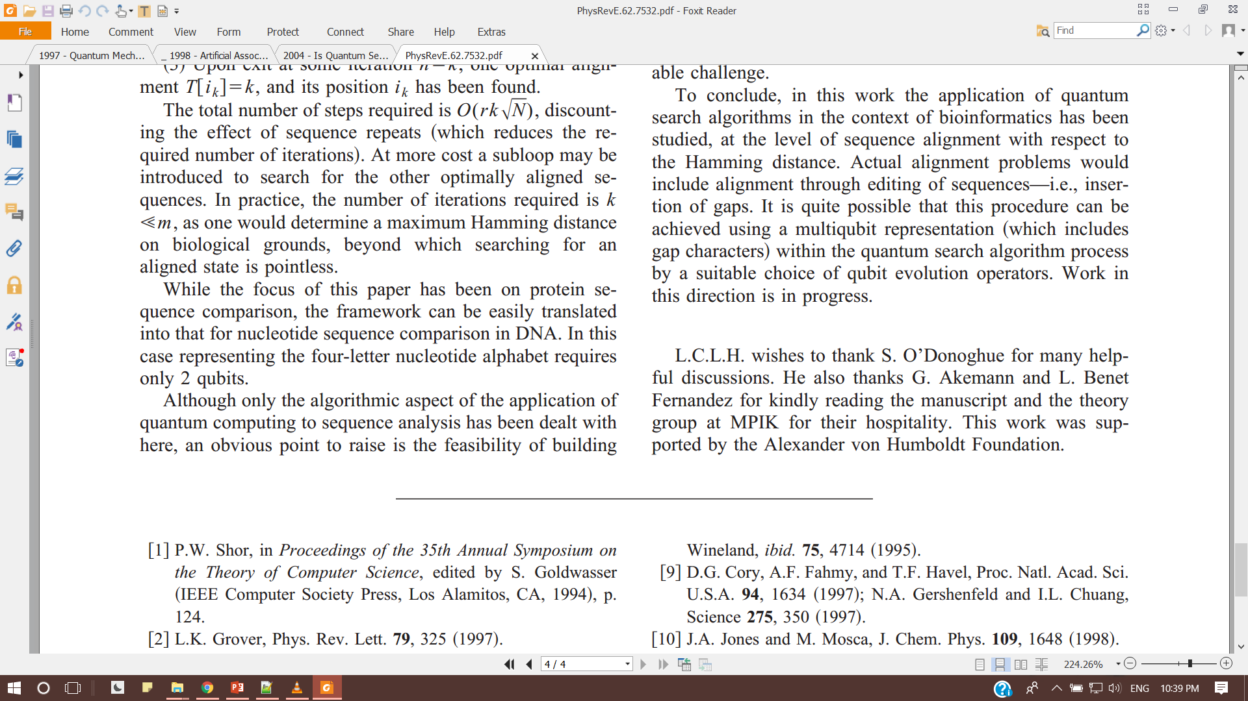
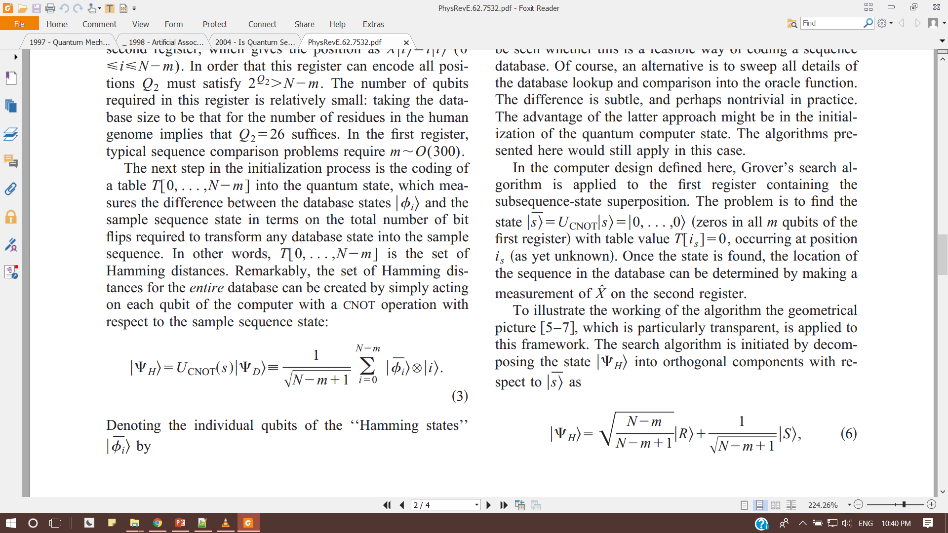
QuAM+QPM
Only previous reference using Grover
quantum algorithm for protein/DNA sequence alignment
Does not refer QuAM/QPM, but
based on Hamming distances like QuAM
based on Initialization Circuit encoding like QPM
TBDs
construct circuit from mathematical descriptions in paper
check claim of using CNOT ladder for Hamming function
check if Oracle dependence on SR can be made runtime
check qubit+ancilla requirement scaling overhead

Slide 31
Plan for next month
Circuit simulation
Port MATLAB code to OpenQL (make python basic library)
Run in QX
QPM
simulate Genome Sequence
white-box testing
QuAM modifications
use Unitary matrix
encode index in Store step
Zhou et al. improvements
{ (a,b,?,?) } v.s. { (?,?,a,b), (?,a,b,?), (a,b,?,?) }
+ { (a,?,b,?), (?,a,?,b), (a,?,?,b) }
reproduce(/improve) Hollenberg paper
QFT based algorithms
+ suggestions

Slide 32
Quantum accelerated Genome-sequence analysis
Month 1½ Highlights
M.Sc. Thesis Project

Slide 33
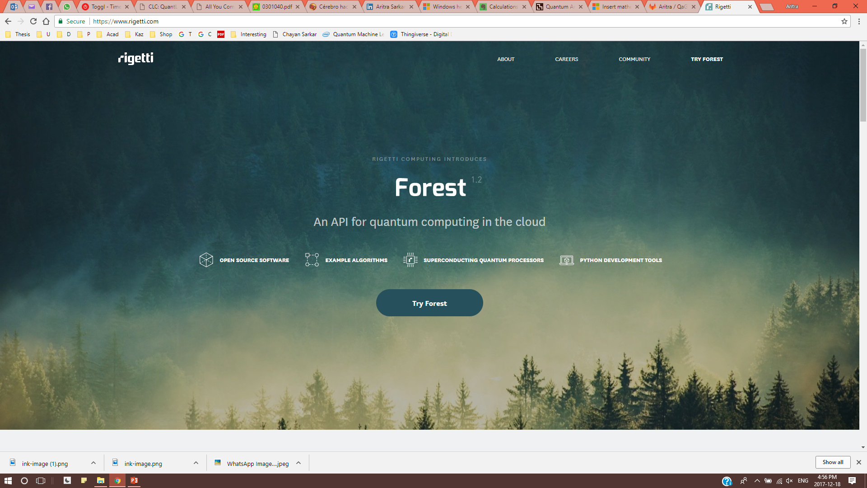
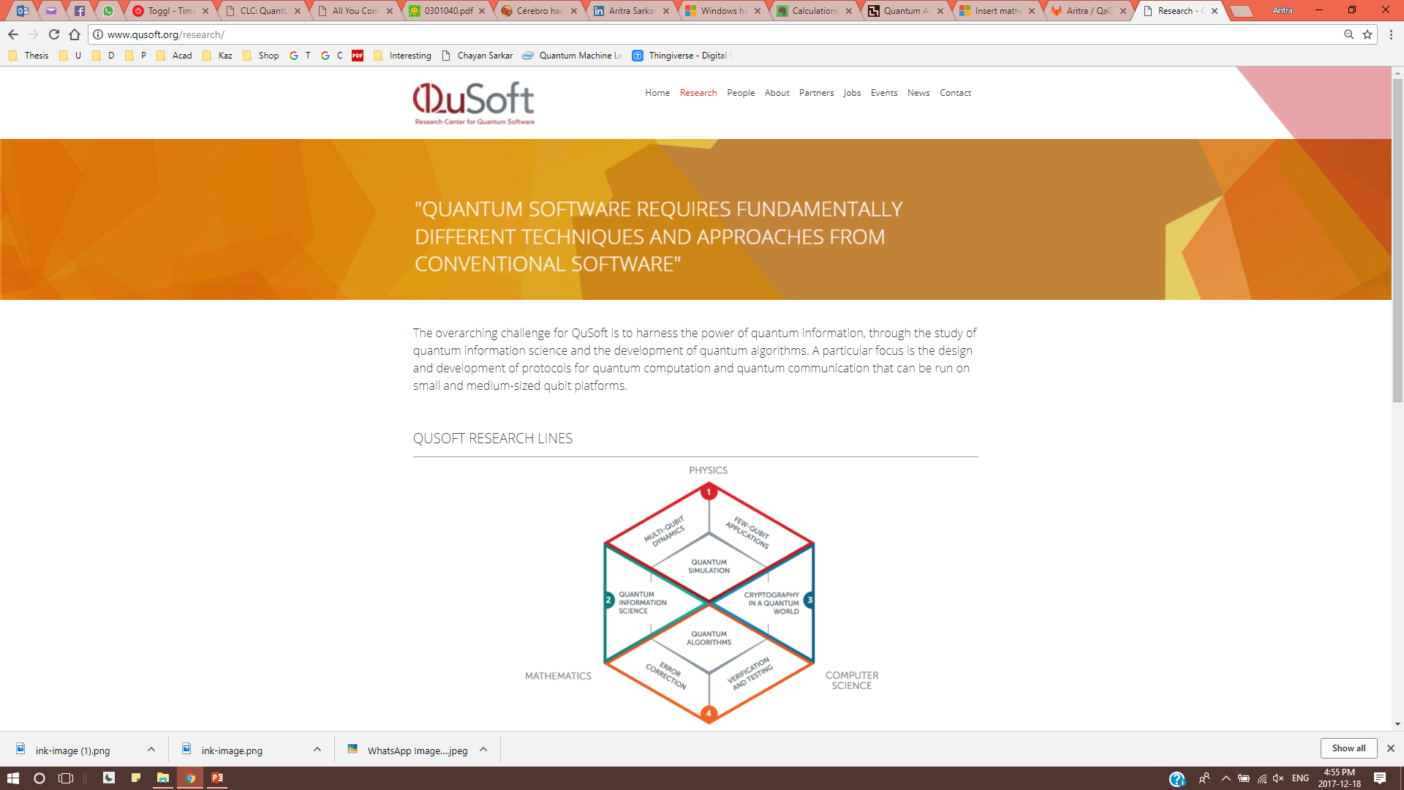
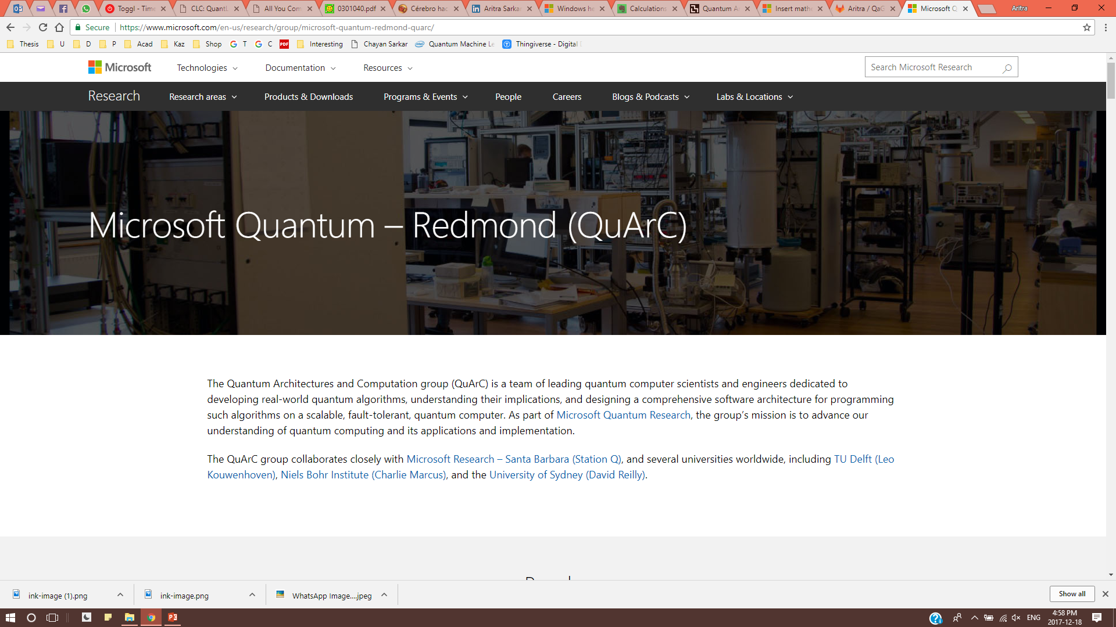
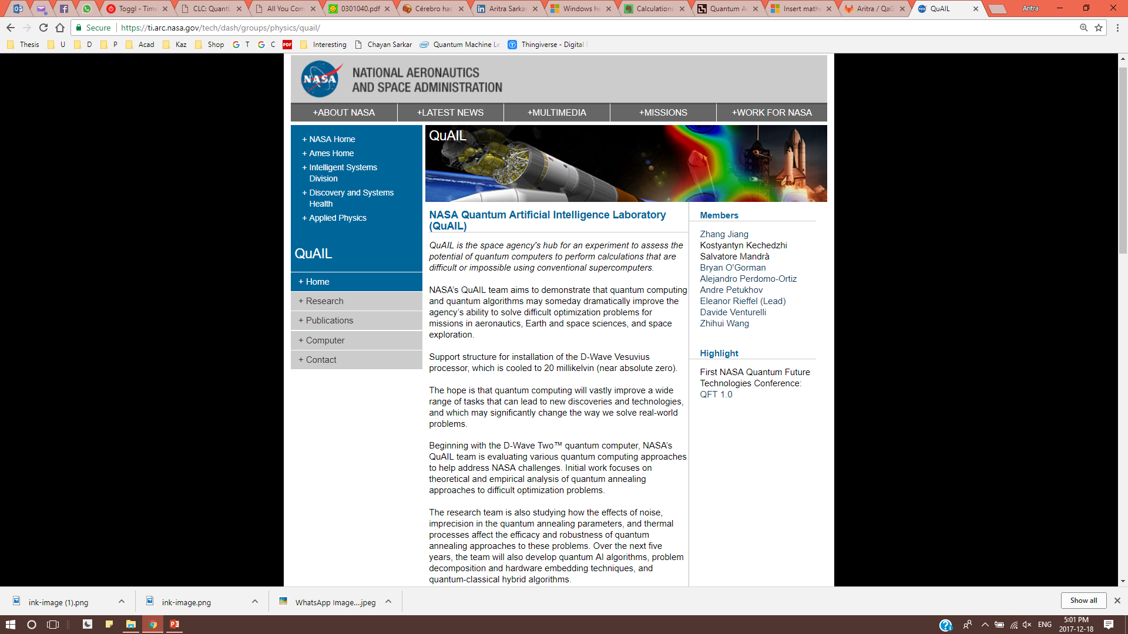
Others

